Slide 1
Introduction to Testing

Slide 2
Outline
Introduction to Testing
Levels of Testing
Unit Testing
Test Driven Development

Slide 3

Introduction to Testing

Slide 4
What is Testing?
Software testing is the process of evaluating and verifying that a software application or system meets specified requirements and functions correctly.
During Software testing, software components are executed and evaluated to identify bugs, errors, gaps, or missing requirements compared to expected behavior and/or functionality.
Common terminology in testing includes:
Bug/Defect - An error or flaw in the software that causes it to produce incorrect or unexpected results.
Test Case - A specific set of conditions, inputs, and expected outcomes used to verify a particular aspect of the software.
Test Suite - A collection of test cases that are grouped together, often to test a specific feature or module.
Test Coverage - A measure of how much of the code or requirements are tested, often expressed as a percentage.
False Positive/Negative - A false positive is when a test fails but the software is actually working correctly; a false negative is when a test passes but there's actually a bug.
Pass/Fail Criteria - The standards that determine whether a test case has succeeded or failed.
Test Environment - The setup of hardware, software, network configurations, and test data where testing is performed.

Slide 5
Basics of Testing
Testing is a very broad term that encompasses many different strategies, levels and techniques.
Software testing can be done either:
Manually (by a human using the system)
automated by writing tests with code.
Generally, when we discuss software testing, we are referring to this approach.
You’ve probably already performed manual testing by simply running your application code, providing some user input, and manually observing the resulting behavior.
This kind of testing is effective but does not scale well as the size of an application increases to 100, 1000s or tens of thousands of lines of code.

Slide 6
Basics of Testing (cont…)
Any time you develop software, testing should be considered as a crucial component to your development process.
Testing should not be:
Optional
An afterthought
A chore
Time-consuming
Strictly about ‘code coverage’
When creating and executing tests you should make sure that you:
Clarify the unambiguously state the requirements of the system
Ensure software meets expectations and helps achieve business objectives
Can easily identify areas that do not meet requirements
Quickly and easily make changes to the application and tests if needed
Assume product quality.

Slide 7
Levels of Testing

Slide 8
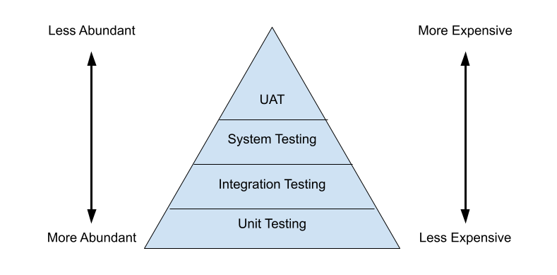
Testing Pyramid
When determining costs for tests, it is useful to keep the ‘Testing Pyramid’ in mind.
This is a visual representation of the cost vs abundance of tests based on certain “levels” of testing.
More tests exist at lower levels of the pyramid, than the top, because they exist at a lower level of abstraction.

Slide 9
Testing “Levels”
*Unit Testing*
Most Micro-level of testing
Test each component in isolation (without dependencies)
Usually requires mocking data
Unit testing tools include JUnit and TestNg
Integration Testing
Test components with dependencies
Check that components work with one another correctly
Logically related modules are tested as a group
Integration testing tools include selenium and protractor
System Testing
Test the entire application as a whole
Ensure the entire application works without errors
User Acceptance Testing (UAT)
Test that all requirements are met
Simulate an end-user to guarantee that users can perform all the tasks required
Generally, UAT is handled by a physical user
Two forms of UAT exist: Alpha and Beta
Alpha Testing – First round of UAT (normally in-house builds and teams)
Beta testing – Generally, testing done ‘out-of-house’

Slide 10
Common Types of Testing
Functional Testing - Verifies that the software performs its intended functions correctly.
This is crucial because it ensures the application delivers the features users actually need.
Performance Testing - Evaluates how the system performs under various loads, including speed, scalability, and stability.
Important for ensuring the application can handle real-world usage patterns.
Usability Testing - Assesses how easy and intuitive the application is for end users.
Important because even technically sound software fails if users can't navigate it effectively.
Sanity Testing - A narrow check of a specific area or function after making a small change.
Important because it quickly confirms a fix didn't break something obvious.
Smoke Testing - A preliminary test that checks basic, critical functionality to determine if the build is stable enough for further testing.
Saves time by catching major issues early.
Exploratory Testing - Unscripted testing where testers actively explore the application to find unexpected issues.
Important for discovering edge cases that structured tests might miss.
Load Testing - Tests system behavior under expected user loads.
Helps prevent crashes or slowdowns during peak usage periods.
Stress Testing - Pushes the system beyond normal capacity to find its breaking point.
Important for understanding system limits and planning for growth.
Regression Testing - Re-runs previous tests after changes to ensure new code hasn't broken existing functionality.
Essential for maintaining stability as software evolves.

Slide 11
Unit Testing

Slide 12
Unit Testing
Unit Testing is the testing of individual software components in isolation from the rest of a system.
This is done by writing tests which execute the code on the individual units we want to inspect.
When the code under scrutiny deviates from an expected outcome or behavior, the test will fail.
If the test passes, this means that application performs as expected (unless there is a problem with the test itself).
Unit testing should never manipulate actual databases or use real data. It is the process of testing the functionality, without changing the actual environment.

Slide 13
Unit Testing
New Code
Once a developer adds more code, they need to write unit tests for the new code to ensure it is working properly
Alternatively, Tests can be written first if utilizing Test Driven Development
Refactoring
As projects grow and requirements change, code made need to be updated
Refactoring involves updating code on a later date and testing to make sure everything is still running smoothly, or quickly find what causes tests to fail.
What is a Test Case?
A test case is a set of conditions or variables under which a tester will determine whether an application is working correctly
Once we break up our code into a unit, we can come up with test cases that will determine if the unit is working correctly.

Slide 14
Unit Testing
Unit Testing is about more than running source code against tests…
Unit tests prioritize testing source code in isolation
This process entails testing the “smallest unit” of code possible. This unit is often, for instance, a single method.
If one of these units (a method) depends on another unit, testers typically use mocks or stubs to isolate the unit from its dependency during the test.

Slide 15
Unit Testing - Benefits
Encourages writing testable code
Isolate defects in source code
Cost-effective
Improves Overall Code Quality
Promotes Confidence when refactoring

Slide 16
Test Driven Development

Slide 17
Test Driven Development
When developing software, it is important to ensure that most, if not all, of the code being written is tested to verify the functionality of the code.
One way to ensure this, is to follow a process called ‘test-driven development’ or TDD.
The TDD process consists of writing unit tests first, before the application code has been written. Then, code can be written to make the test pass, and the process can be completed for each piece of functionality required.

Slide 18
TDD Process
To follow a TDD process you would:
Write a unit test
Run the test => the test will fail
Fix the text by writing application code
Retest the code.
If the code fails: refactor the application code and test again
If the code does not fail: Repeat for the next test
Following the TDD process can be useful to ensure that a valid unit test always exists for any class or method that is written.
Later, when refactoring code, the unit tests give us confidence that we can change the source code without breaking functionality.
If we mess up somewhere, when the unit tests are run, we can pinpoint exactly where the problem lies.
This makes debugging much easier.

